Slide 1
Trial 4
Physical layout
XVR Simulation
21 November 2018, Netherlands

Slide 2
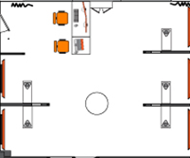

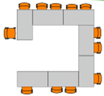
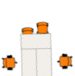

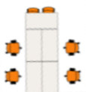
Physical layout – Baseline (Flood & Threat)
Scenario coordinator
Response cell – GBT & higher
Technicians
& support
Response cell – Water & critical infra
Response cell – Police & Defence
LCMS
Response cell – Medical
Response cell – Fire & CoPI’s
3Di
ROT
LCMS
LCMS
Water board
LCMS
LCMS
LCMS
LCMS
AC Police
AC Fire
AC Municipality
AC Evacuation?
AC Medical
Power infra (Stedin)
HTM
International Organisations

Slide 3
Physical layout –Threat Phase (innovation)
Scenario coordinator
Response cell – GBT & higher
Technicians
& support
Response cell – Water & critical infra
Response cell – Police & Defence
LCMS
Response cell – Medical
Response cell – Fire & CoPI’s
3Di
ROT
LCMS
LCMS
Water board
Keep Op.
LCMS
LCMS
LCMS
LCMS
Humlog
AC Police
SimCI
AC Fire
SimCI
Crisis
Suite
AC Municipality
Crisis
Suite
Crisis
Suite
AC Evacuation
AC Medical
Power infra (Stedin)
HTM
International Organisations

Slide 4
Physical layout –Flood Phase (innovation)
Scenario coordinator
Response cell – GBT & higher
Technicians
& support
Response cell – Water & critical infra
Response cell – Police & Defence
LCMS
Response cell – Medical
Response cell – Fire & CoPI’s
ZKI
ROT
LCMS
LCMS
Water board
Keep Op.
LCMS
LCMS
LCMS
LCMS
Humlog
AC Police
Crisis
Suite
AC Fire
Crisis
Suite
Crisis
Suite
AC Municipality
AC Evacuation
AC Medical
Power infra (Stedin)
HTM
International Organisations

